Slide 1

CRM Performance Analysis Report
Data-Driven Insights for Customer Relationship Optimization

Slide 2

Project Summary & Objectives
IMPACT ANALYSIS
ANALYTICAL SCOPE
The primary objective was to deconstruct the sales funnel to identify where high-value leads are lost. By analyzing 10,000 leads, we aimed to provide a blueprint for increasing the 31% conversion rate through targeted industry interventions and geographic focus.
Our methodology followed a rigorous path: Extracting raw CRM logs, transforming them via SQL, validating outliers in Excel, and finally deploying dynamic dashboards that allow stakeholders to pivot data across time, department, and industry sectors.

Slide 3

Core Performance Indicators
31.06%
Total Leads
Total Accounts
10,000
3,052
Sales Price
Expected Amount
Overall Conversion Rate
$192.95M
$184.14M
The CRM data reveals a healthy conversion pipeline with over 3,000 accounts generated from 10,000 leads, maintaining a high sales-to-expected ratio.

Slide 4
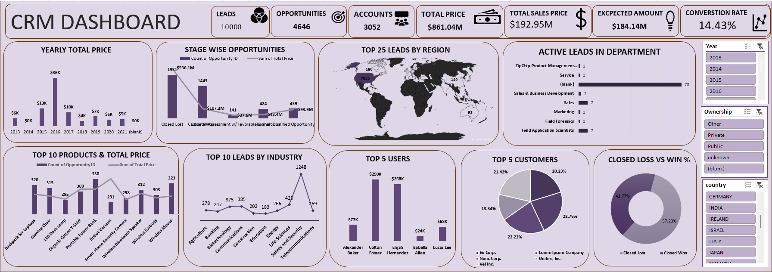
EXCEL

Slide 5
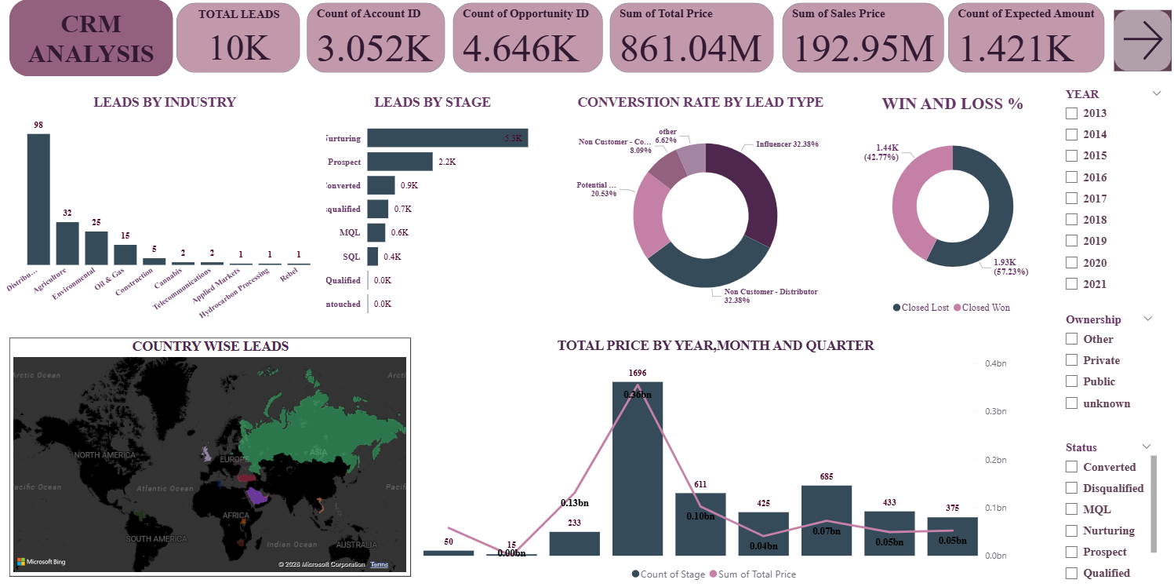
POWERBI

Slide 6
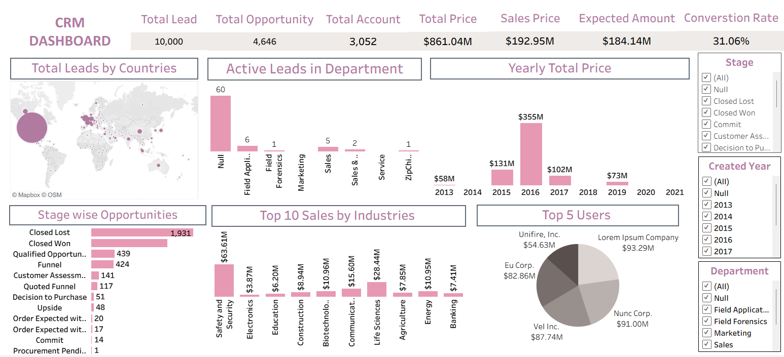
TABLEAU

Slide 7
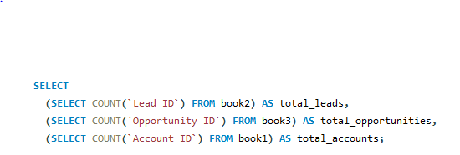
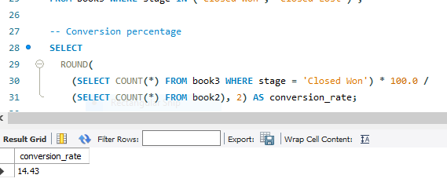
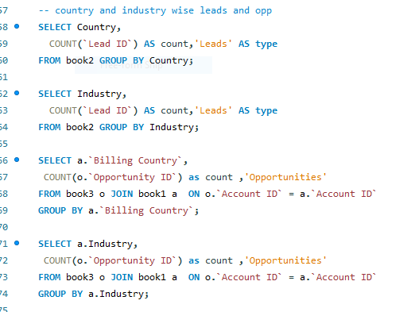
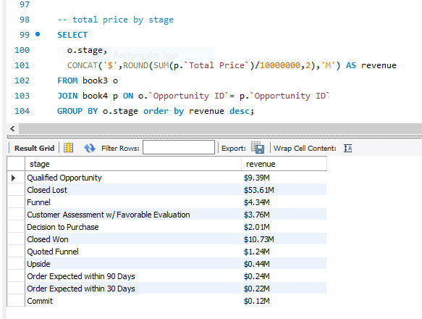

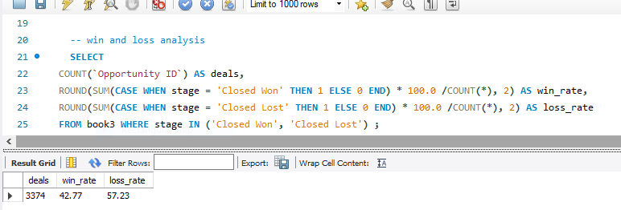
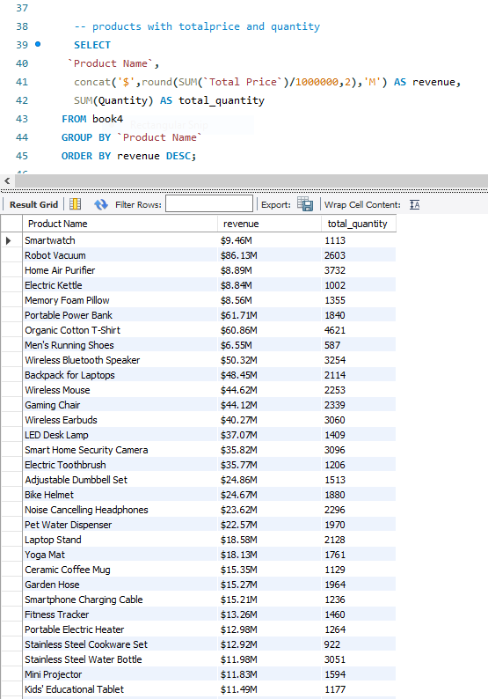
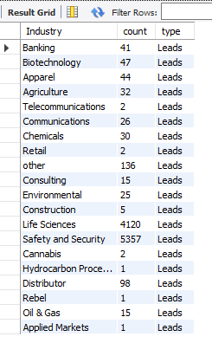
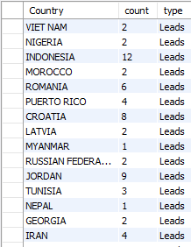
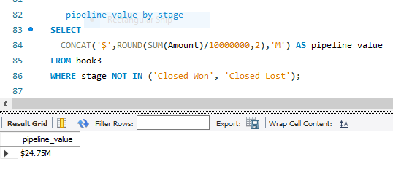
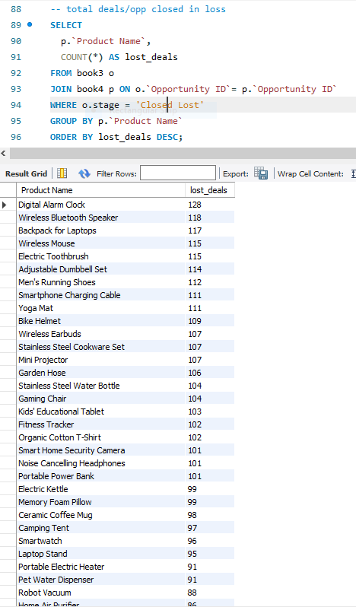
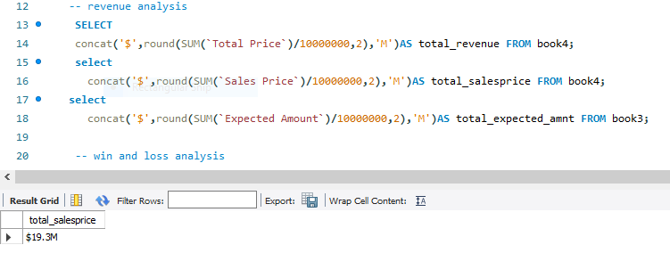
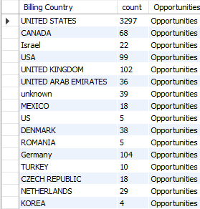
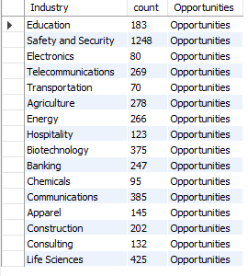
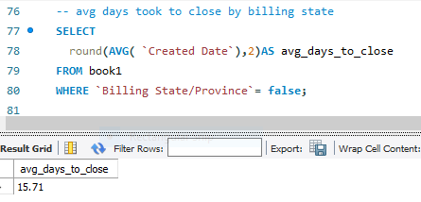


SQL

Slide 8

Key Takeaways & Strategy
Industry Prioritization: The Safety and Security sector represents over 32% of total industry-led sales ($63.41M). Future marketing spend should be disproportionately allocated to this high-yield sector.
Conversion Bottlenecks: With 1,935 leads "Closed Lost" compared to 813 "Closed Won," there is a critical need to analyze the "Qualified Opportunity" stage to prevent leakage in the mid-funnel.
2016 Peak Recovery: 2016 reached a record $355M. Post-2016 trends show a decline; a retrospective review of sales tactics from that period could provide actionable recovery strategies.
Key Clients : Unifiing Inc. is the top contributor ($114M). Strengthening enterprise relationships is critical for recurring revenue.

